Slide 2
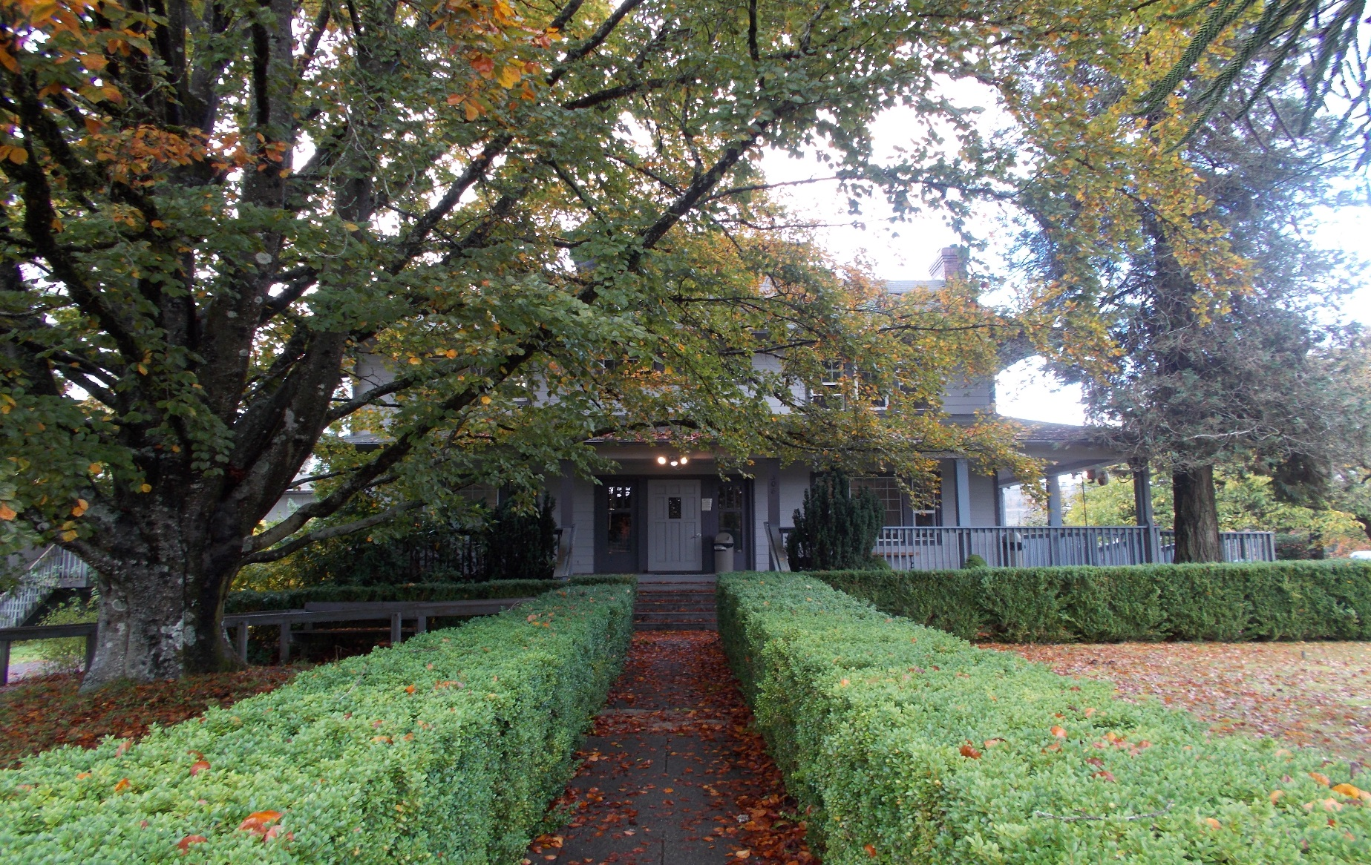
History of the Treatment Center
The naming of NWITC by Bruce Miller
D3WXbiPalil
From The Darkness Into The Light

Slide 3
Treatment Schedule
Denial & Defenses
Grief & Loss
Guilt/Shame
Relapse Prevention
Family Roles
Abuse
WEEK 6 | MONDAY 5/15 | TUESDAY 5/16 | WEDNESDAY 5/17 | THURSDAY 5/18 | FRIDAY 5/19 |  | SATURDAY 5/20 |  | SUNDAY 5/21
6:00 A.M. | Wake up | Wake up | Wake up | Wake up | Wake up
7:00 A.M. | Breakfast | Breakfast | Breakfast | Breakfast | Breakfast |  | 7:30 Wake up |  | 7:30 Wake up
8:00 A.M. | Meditation | Meditation | Meditation | Meditation | Meditation |  | Breakfast |  | Breakfast
8:30 A.M. | Walk | Walk | Walk | Walk | Walk |  | Meditation |  | Meditation
9:00 A.M. | Lecture - Mike Abuse | Lecture - Brock PTSD | Lecture: Sonja Self-Hate/Lateral Abuse | Shirley Luark Childhood Sexual Abuse | Shirley Luark Stages of Healing |  | Graduation: |  | DBT -
10: 30 A.M. | Group Therapy (split) Mike/Delbert | Group Therapy (split) Sonja/Brock | Group Therapy (mix) Mike/Sonja | Lecture – Delbert Healing Abuse | Talking Circle -
 |  |  |  |  |  |  | Lunch - 11:00 |  | Lunch - 11:00
12:00 P.M. | Lunch | Lunch | Lunch | Lunch | Lunch |  | Patients present steps w/T.A.’s |  | Passes 11:30 – 4:00 Family Visiting 12:00 - 4:00 (1)Movie (pts only)
1:00 P.M. | free time/drum available | free time/drum available | free time/drum available | free time/drum available | free time/drum available
1:30 P.M. | Shirley Luark: Childhood sexual abuse | Troy Green: Gambler’s Ed | Graduation | SPEAKER: Ken and Hiedi 1:30-3:30 | Traditional Foods & Medicines 4:00 Sweat (Women) |  | Lecture - Self – Affirmations
2:45 P.M. | DBT | DBT | D.V. Video: Ofi “Rape is.”
4:30 P.M | Walk |  | Walk
5:00 P.M. | Dinner | Dinner | Dinner | Dinner |  |  | 5:15 – Speaker’s Mtg. |  | 5:15 – Speaker’s Mtg.
6:00 P.M. | Video – Mike Journey to Forgiveness | Lecture – Mike Boundaries | Squaxin AA/Women Beading Class w/Mary | Troy Green: Gambler’s Ed | MOVIES |  | Pentecostal Church (as travel allows) every other weekend |  | (1)Movie / Free Time Games
7:30 P.M. | N.A. Meeting | Study - Journaling | A.A. Meeting | Study - Journaling | Study - Journaling |  | (1)Movie / Free Time Games
8:30 P.M. | Study - Journaling |  | Study - Journaling | Study - Journaling | Study - Journaling
10:00 P.M. | Bedtime | Bedtime | Bedtime | Bedtime | Bedtime 11:00 P.M. |  | Bedtime 11:00 P.M. |  | Bedtime
11:00 P.M. | Lights Out | Lights Out | Lights Out | Lights Out | Lights Out 12:00 A.M. |  | Lights Out 12:00 A.M. |  | Lights Out
Put treatment schedule here

Slide 4
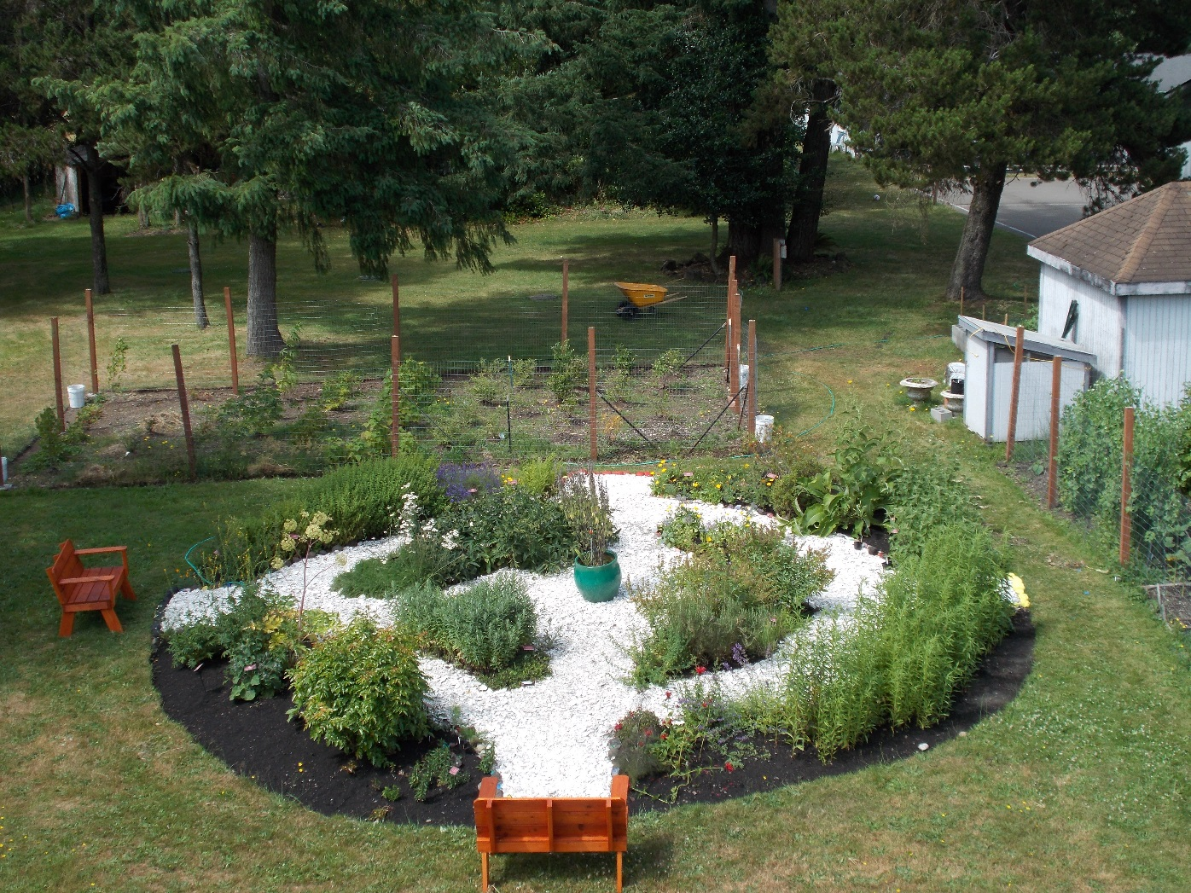
History of the Medicine Wheel and Garden
Envisioned by:
Bruce Miller
June O’Brien
Elise Krohn
Northwest Indian College

Slide 5
Men and Women's Health
Edible Flowers
Violet
Wild Rose
Nasturtium
Kitchen
Stevia
Basil
Chives
Oregano
Rosemary
Sage
Goldenrod
Raspberry leaf
Cough/Cold and Immune
Echinacea
Elecampane
Indian Tea
Marshmallow
Mullein
Thyme
Sacred Herbs
Kinnikinnick
Mugwort
Sweet Grass
First Aid and Skin Health
Calendula
Comfrey
Plantain
Yarrow
St. John’s Wort
Diabetes and Digestive Support
Burdock
Fennel
Fireweed
Oregon Grape
Peppermint
Angelica
Depression, Anxiety, & insomnia
Chamomile
Lavender
Lemon Balm
Skullcap

Slide 6
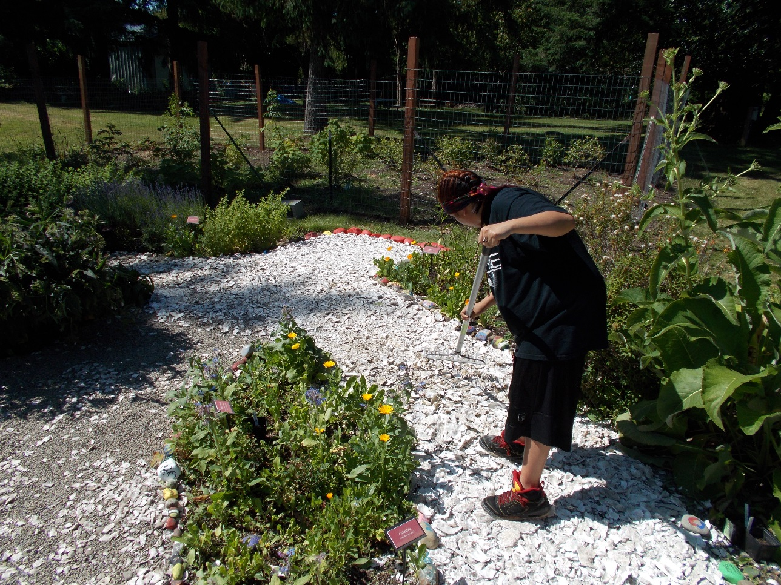
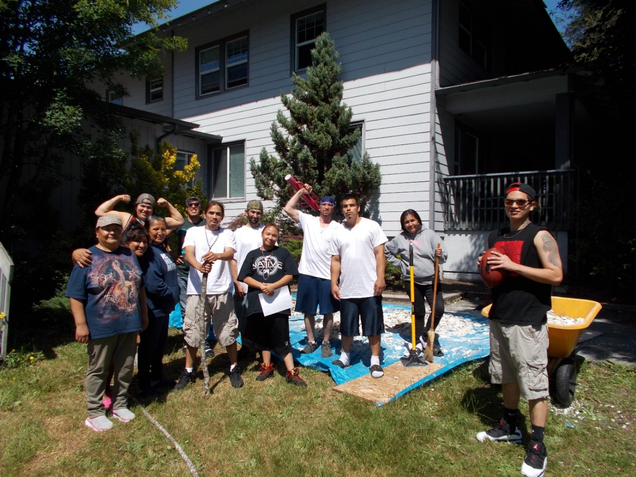

Slide 7
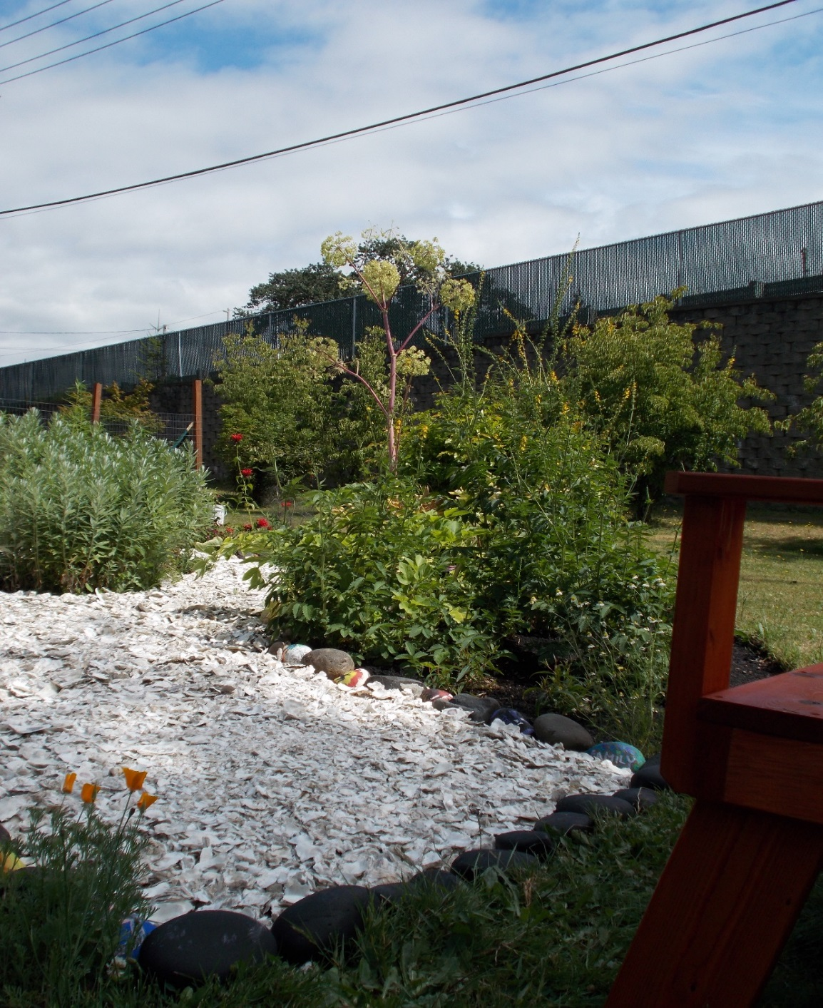
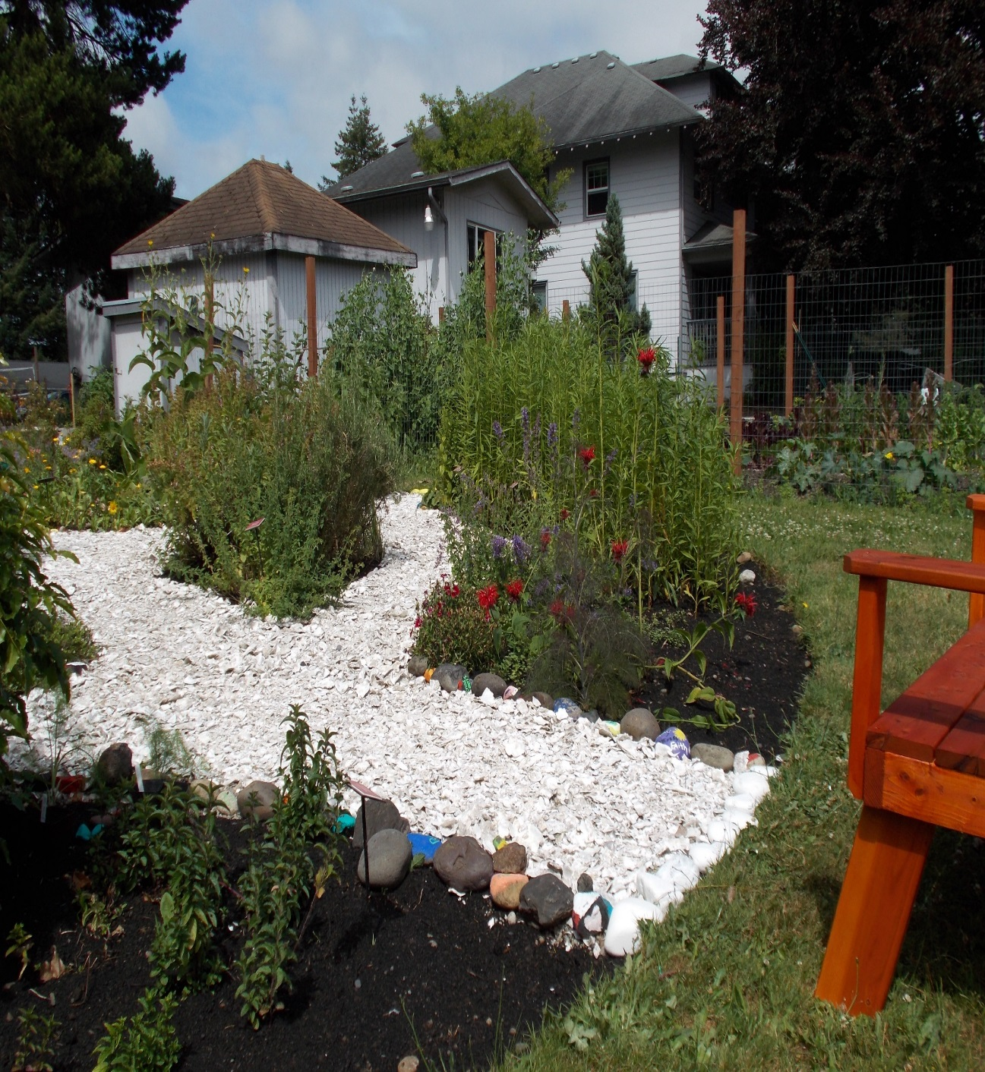

Slide 8
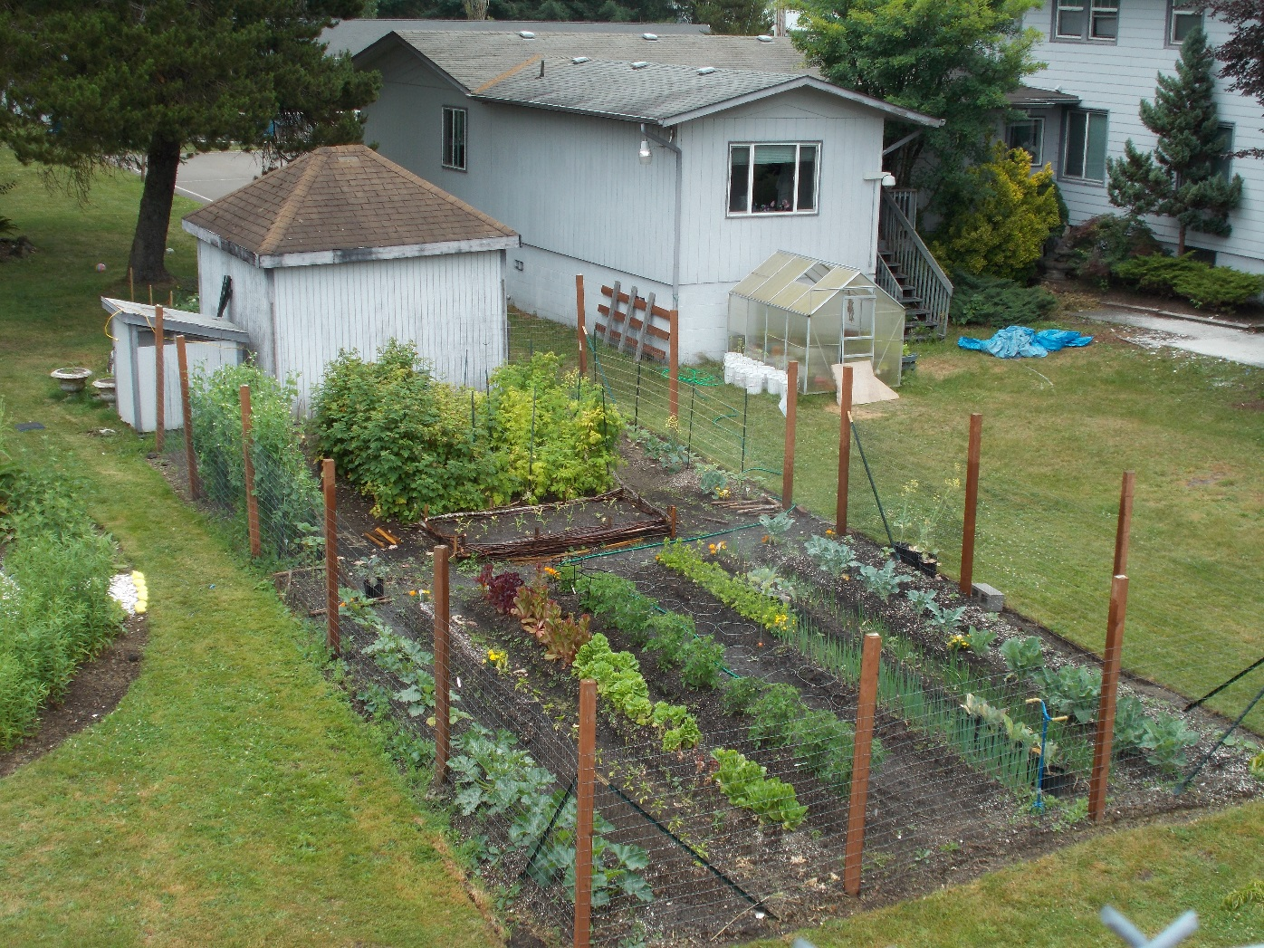
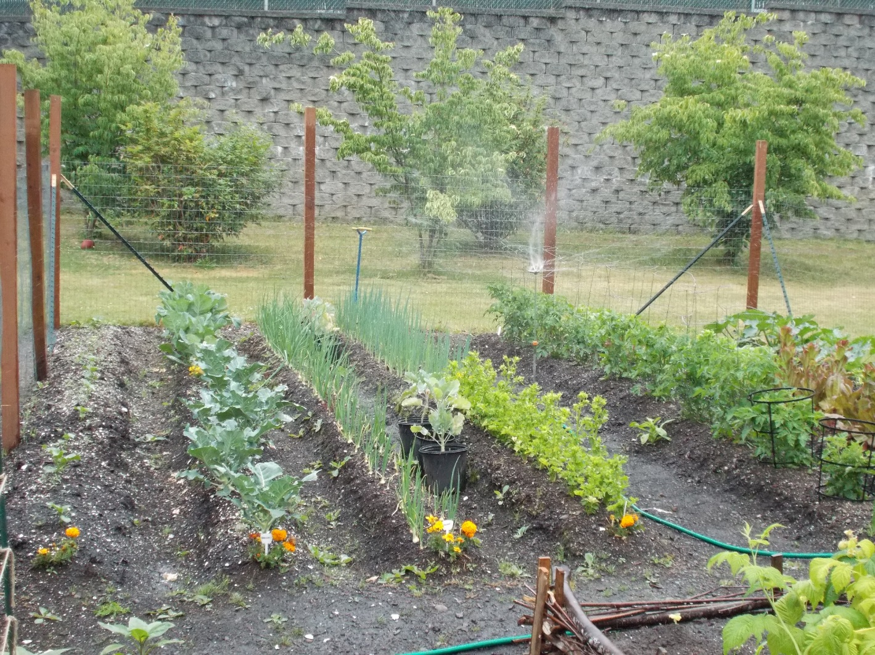
Vegetable Garden

Slide 9
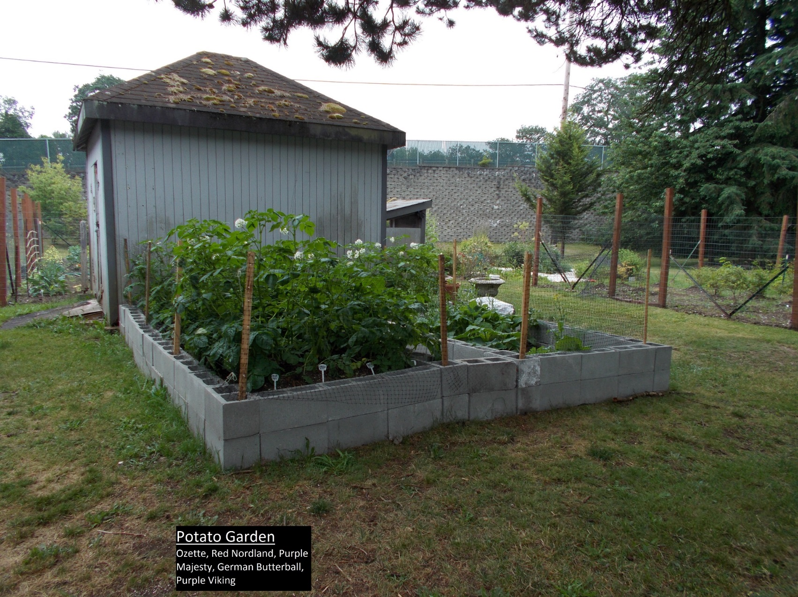
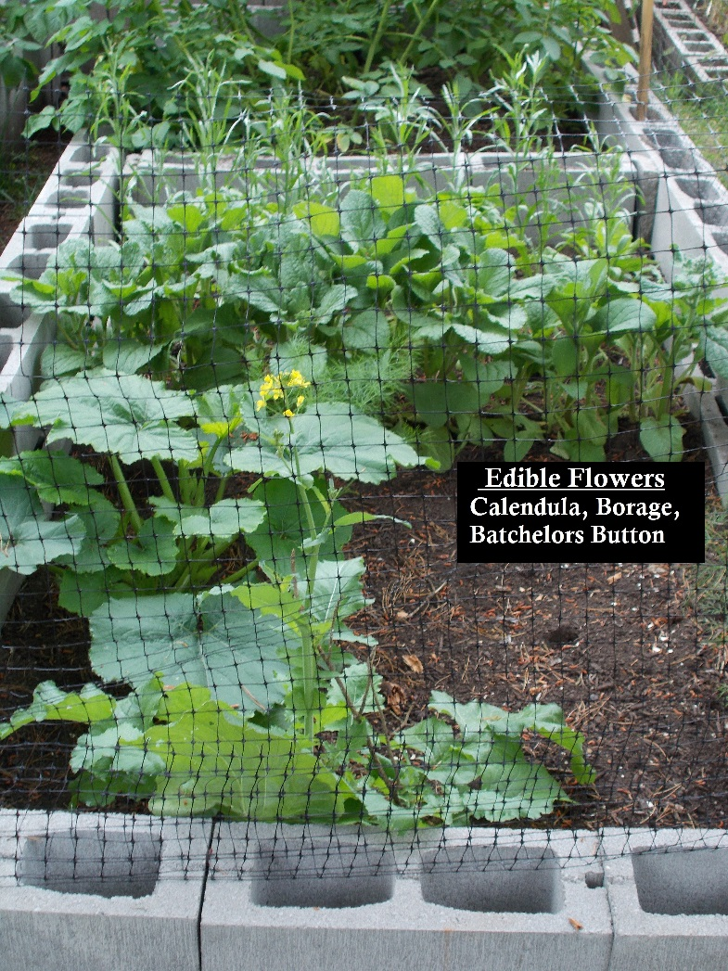

Slide 10
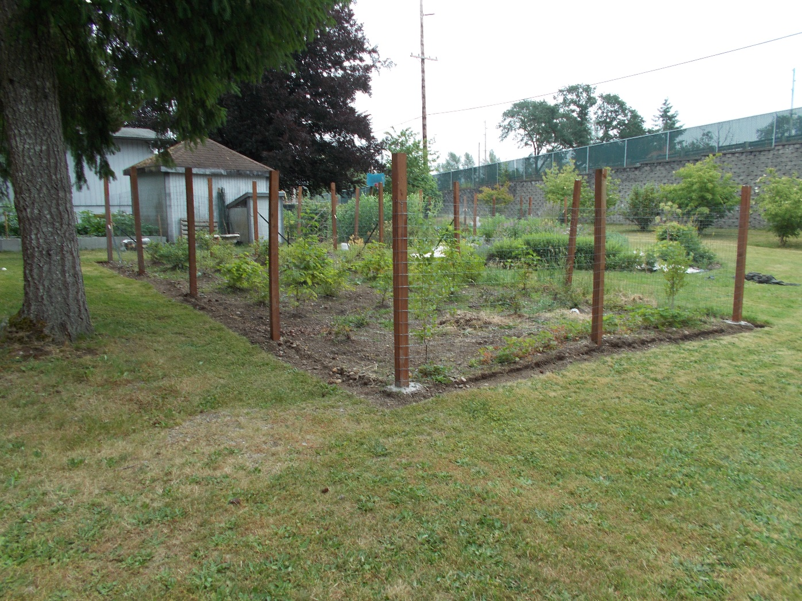
Blueberry
Thimble Berry
Salmon Berry
Blue Elderberry
Evergreen Huckleberry
Red Huckleberry
Hawthorn Berry

Slide 11
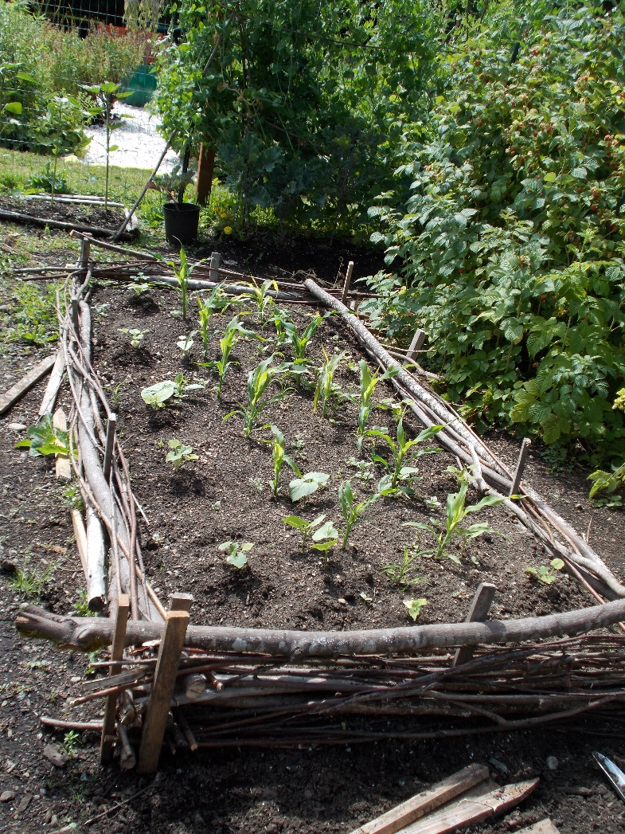
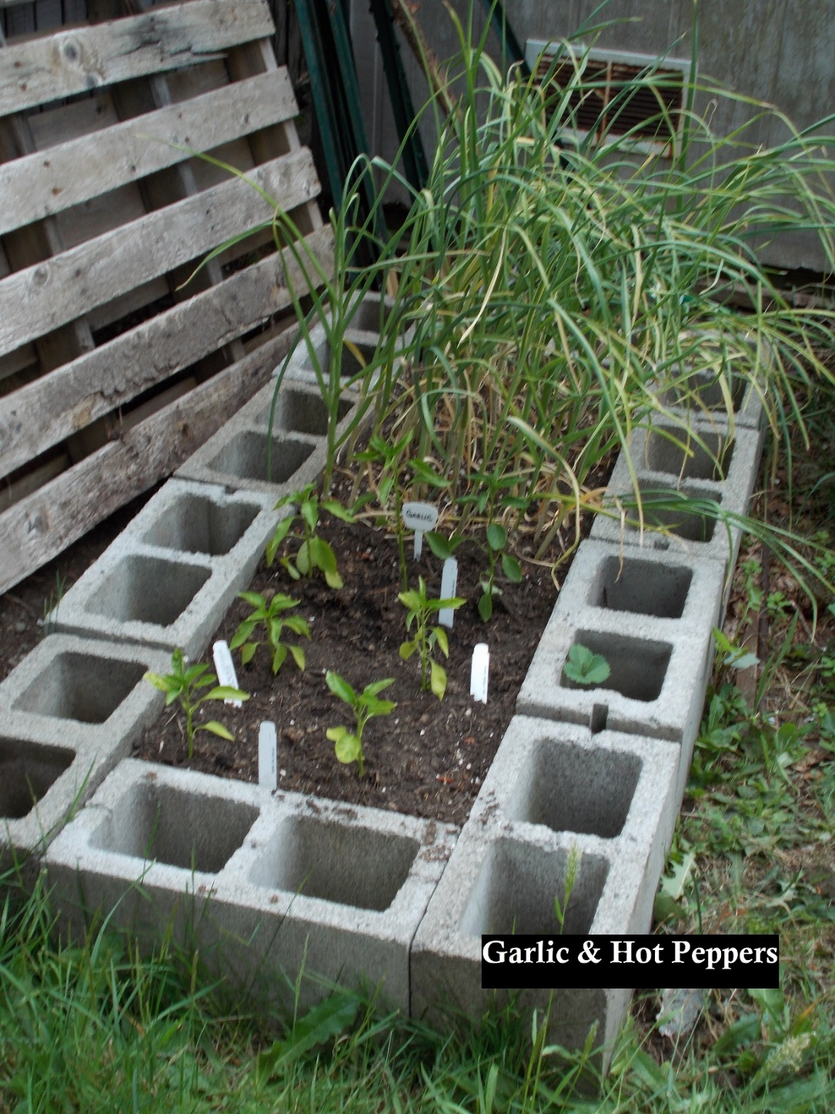

Slide 13
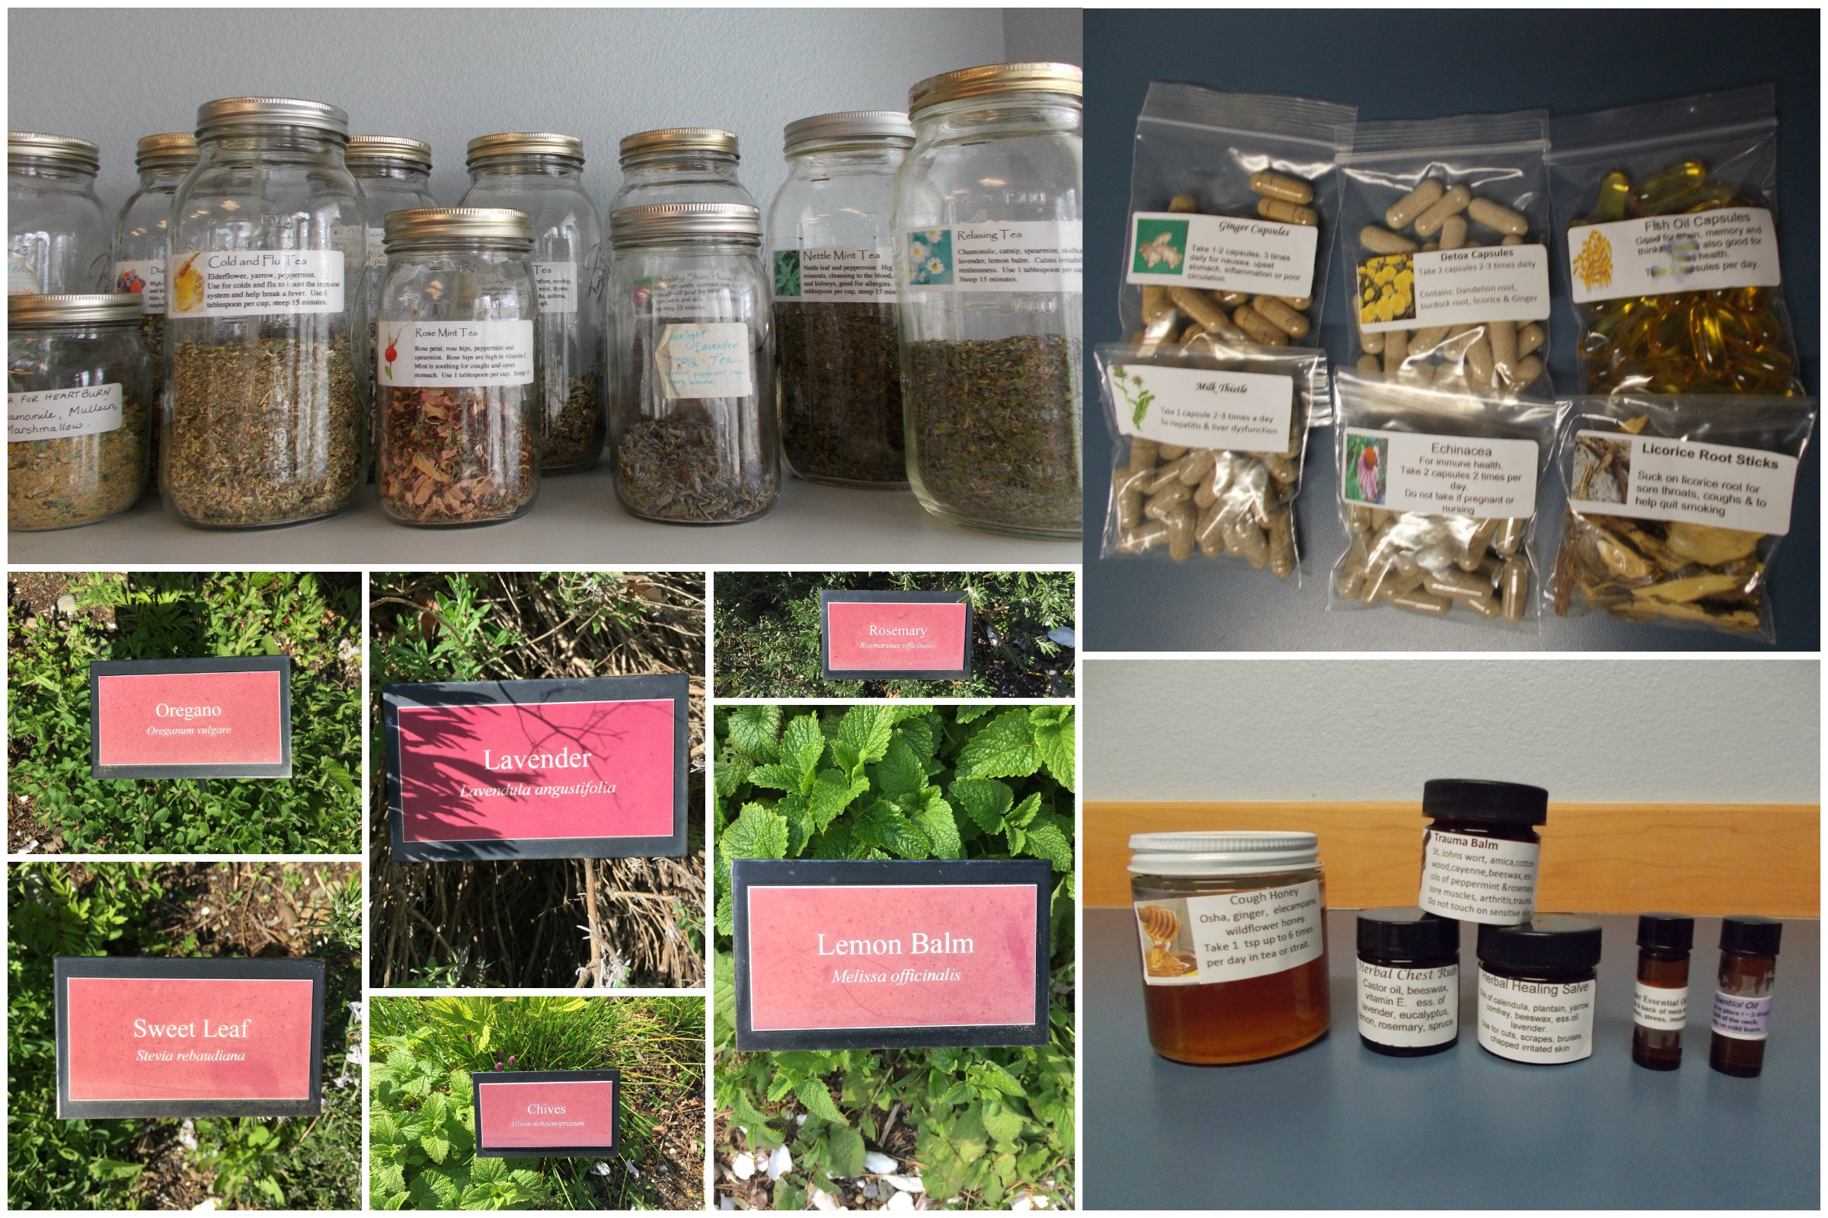
How the garden/medicine class works with treatment
Harvest
Medicine goes in our food
Pay it forward

Slide 14
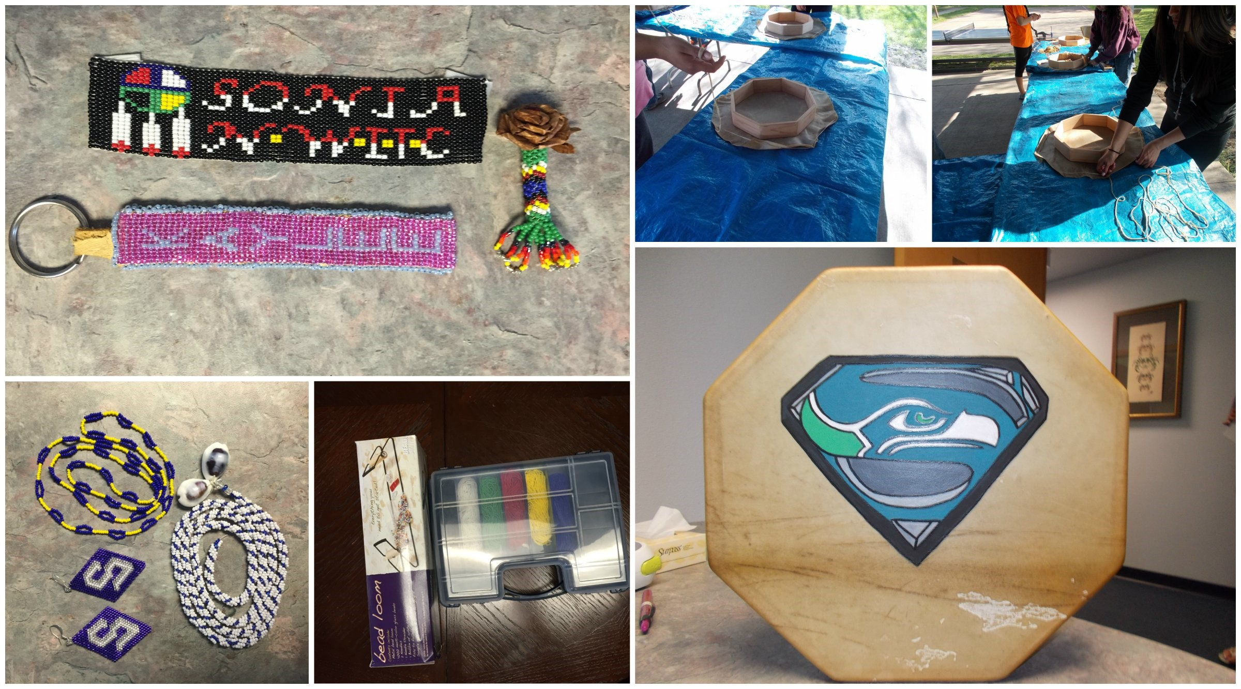
Classroom Participation
Dandelion Fritters
Pemmican
Rattles
Drums
Medicine Bags
Painting Rocks
Honeys
Beading

Slide 15
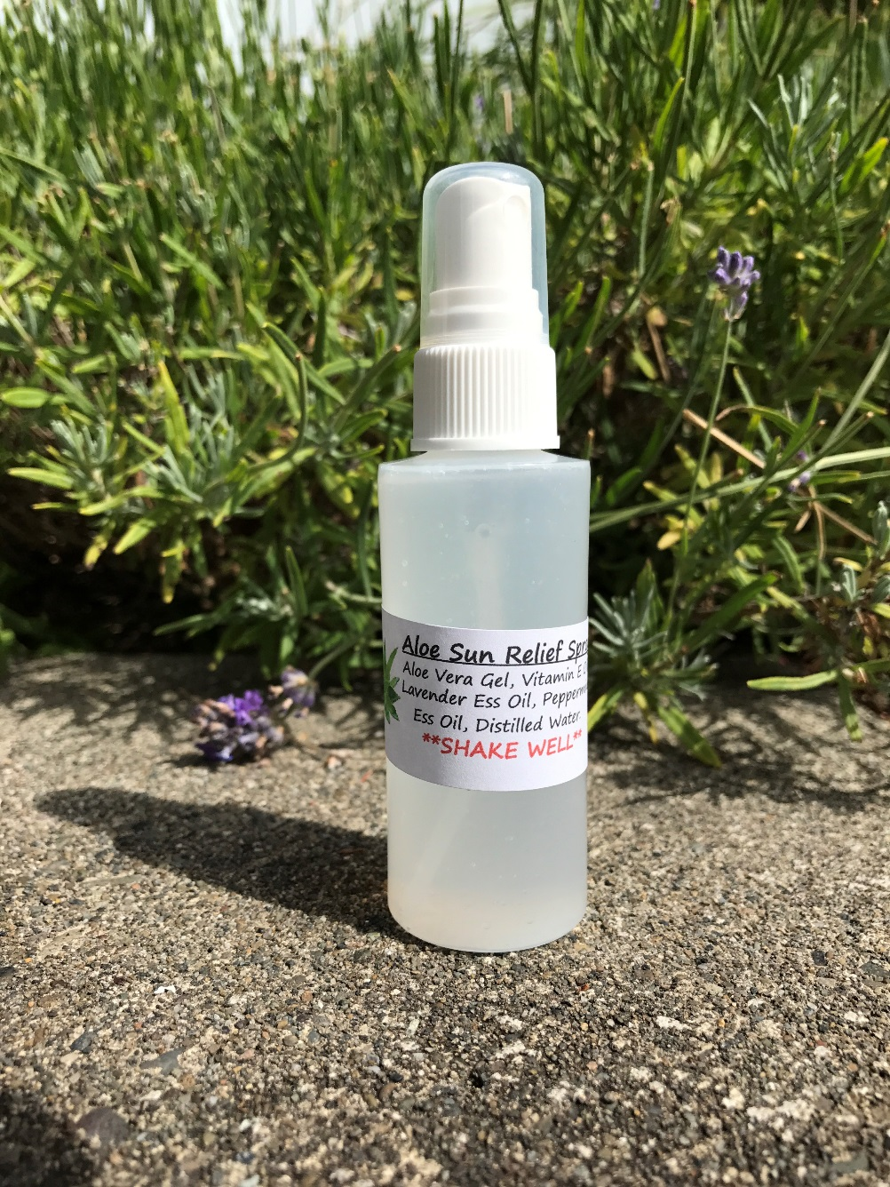
Demonstration
Aloe Sun Relief Spray Ingredients
Aloe Vera Gel
Vitamin E Oil
Lavender Essential Oil
Peppermint Essential Oil
Distilled Water

Slide 16
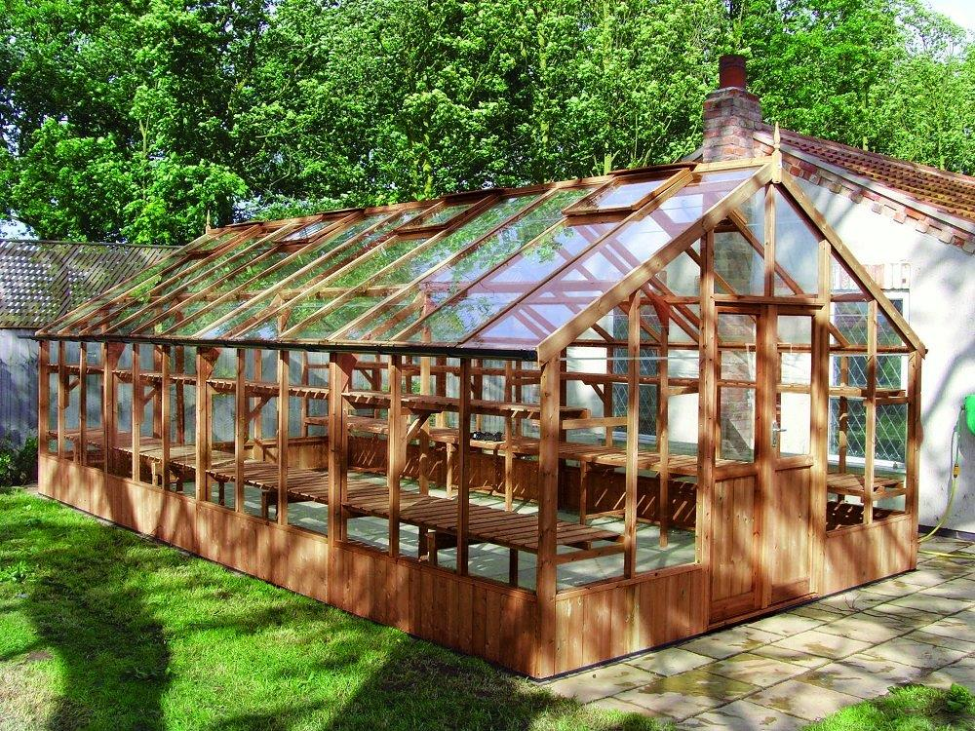

Slide 17
Questions or Comments?
Contact info:
Northwest Indian Treatment Center
Stephanie Tompkins
Kia Demiero
stompkins@squaxin.us
360-482-2674

